Slide 1


Car Price Prediction (Ml project)

Slide 2
Problem Statement
Used car prices vary with many factors, making it difficult to estimate the fair selling price. This project aims to build a model that predicts car prices accurately.

Slide 3
Project Introduction
Dataset
The dataset contains details of used cars from CAR DEKHO.csv, including attributes like name, year, selling price, km driven, fuel type, seller type, transmission, and ownership
Tools
Python – Programming language
Pandas, NumPy – Data cleaning & preprocessing
Matplotlib, Seaborn – Data visualization
Scikit-learn – Model building & evaluation
Jupyter Notebook / Google Colab – Development environment

Slide 4
🔄 Data Processing Steps
Loading Dataset – Import data using Pandas
Handling Missing Values – Checked and filled/removed null values
Data Cleaning – Removed duplicates, corrected inconsistencies
Feature Engineering – Created new features (e.g., Age from Year)
Encoding Categorical Variables – Converted strings (Fuel, Seller_Type, etc.) into numeric form
Scaling / Normalization – Prepared data for model training
Train-Test Split – Divided dataset into training and testing sets

Slide 5
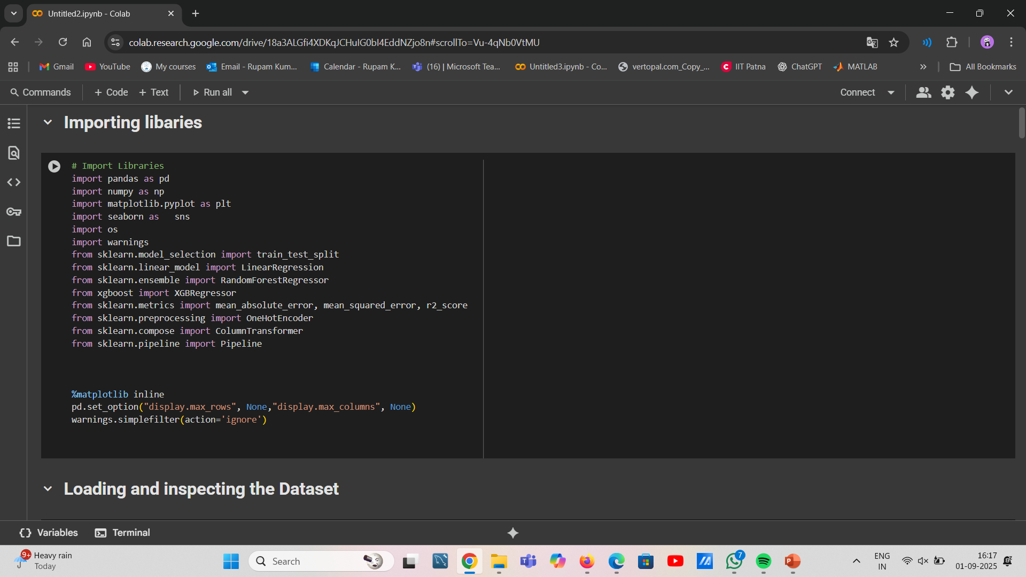
IMPORTING LIBARIES

Slide 6
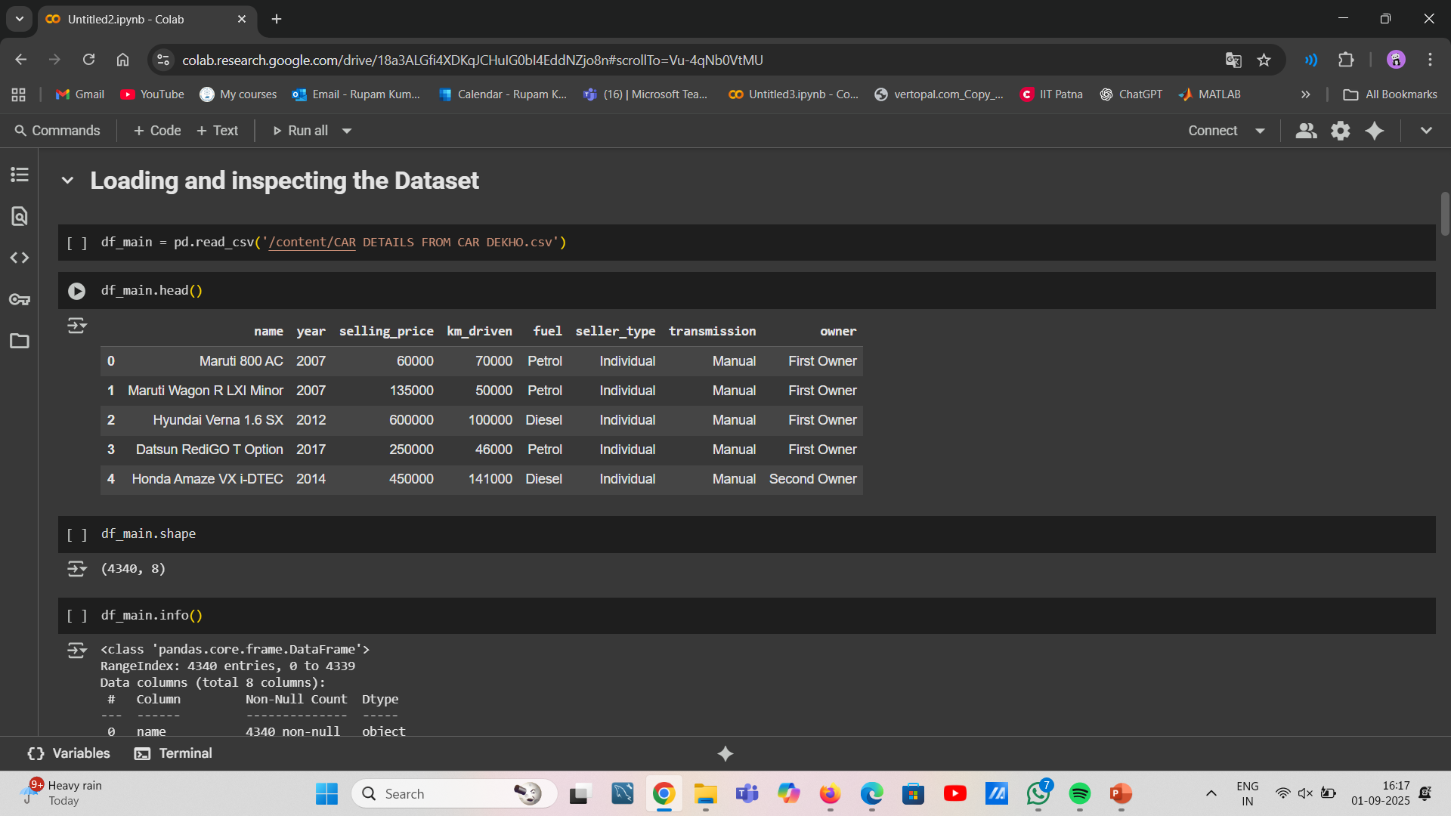
LOADING AND INSPECTING THE DATASET

Slide 7
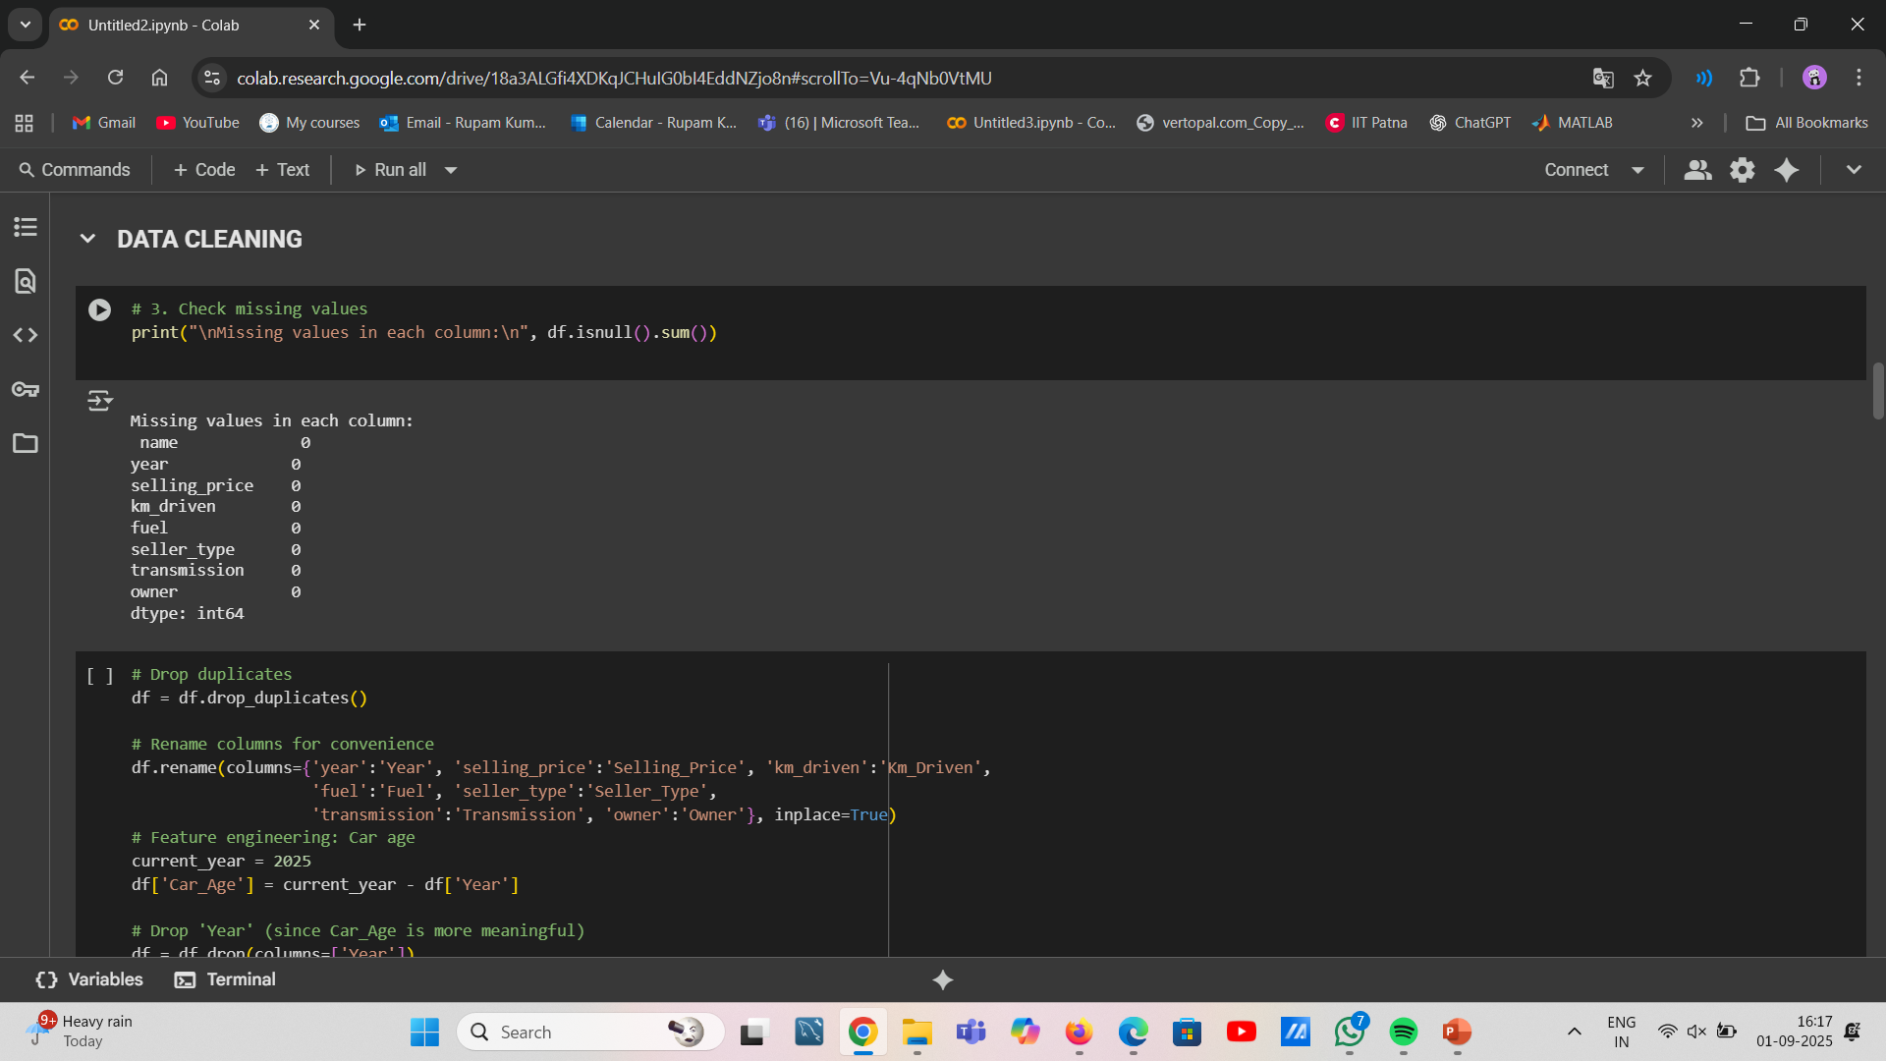
DATA CLEANING

Slide 8
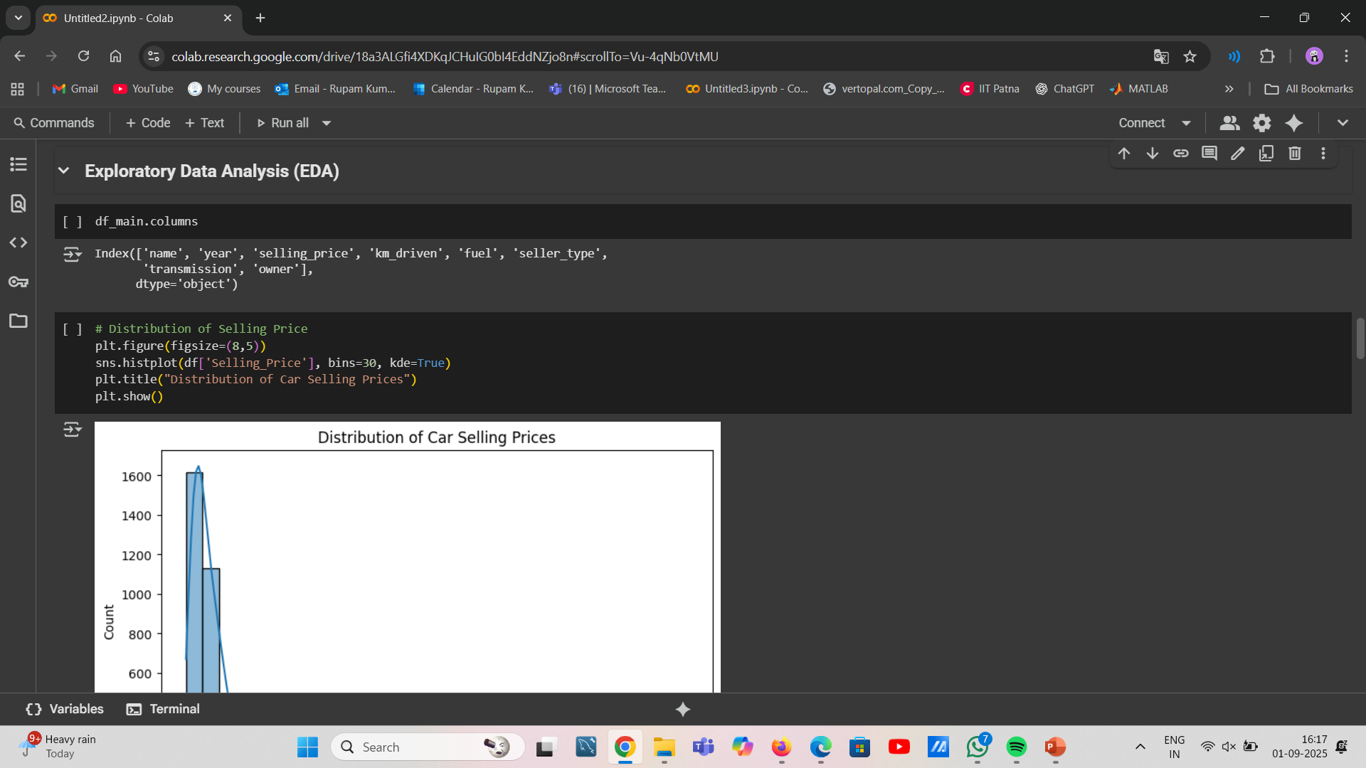
EXPLORATORY DATA ANALYSIS(EDA)

Slide 9
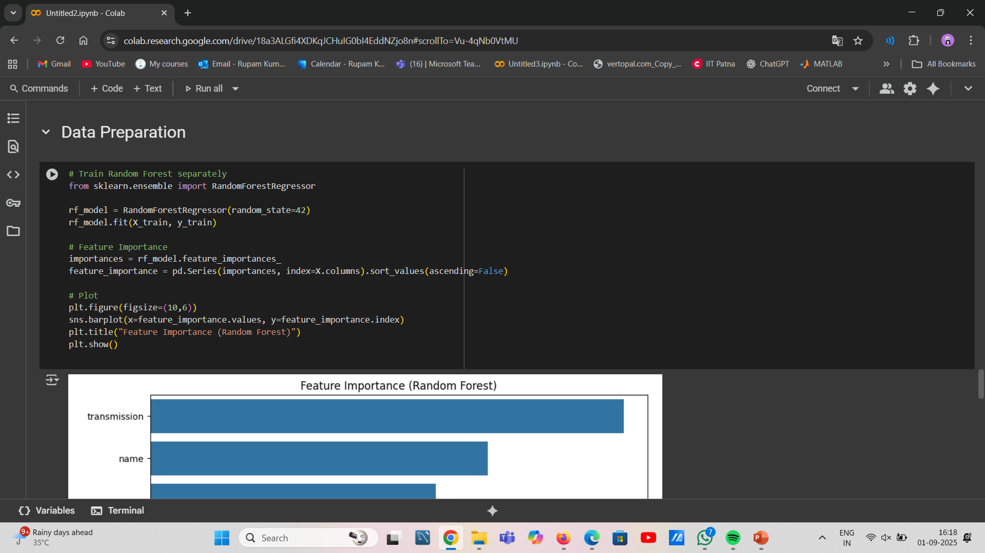
Data preparation

Slide 10
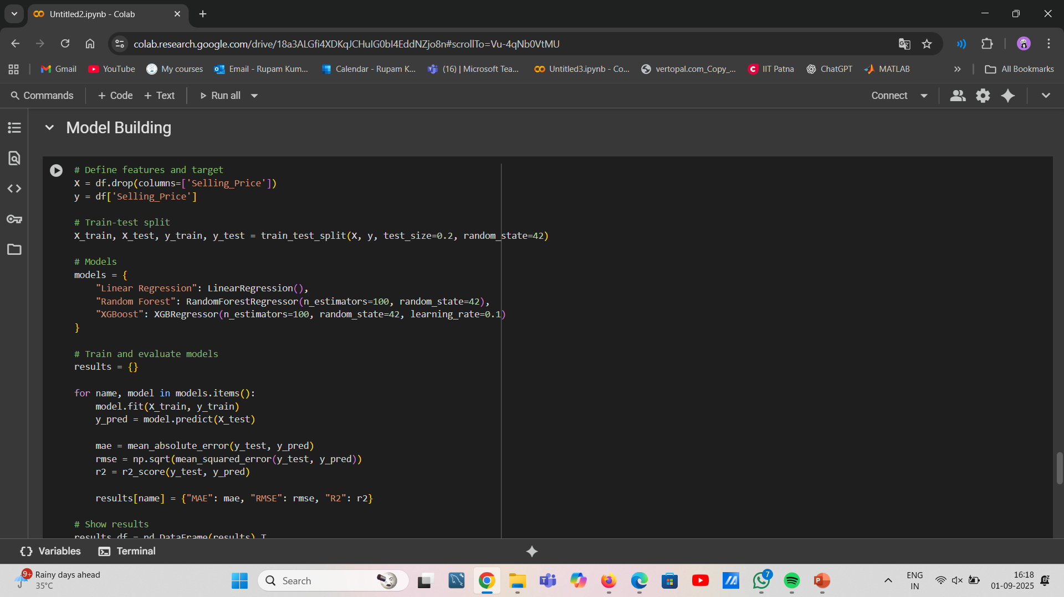
Model building

Slide 11
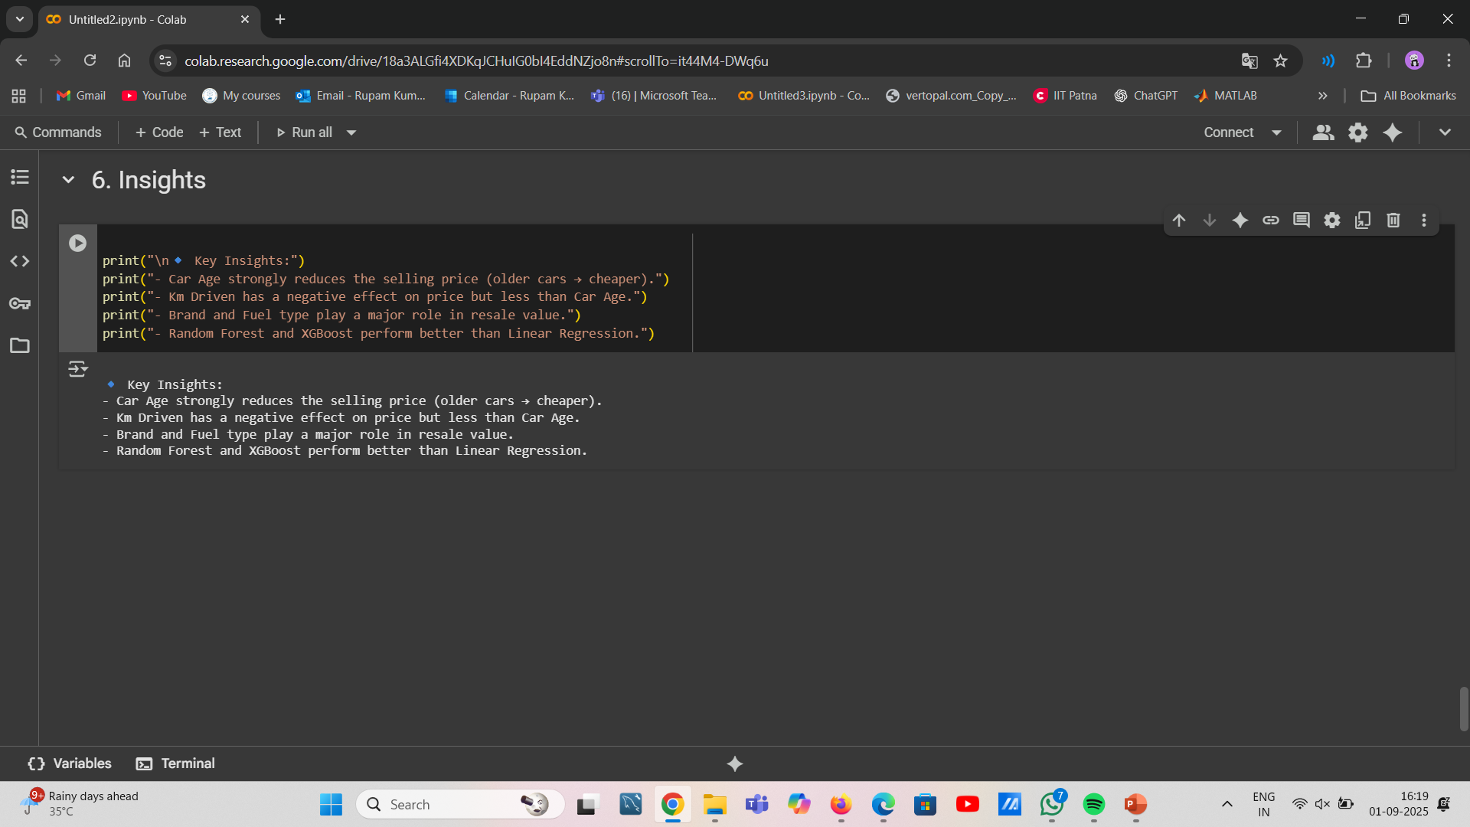
Insights

Slide 12
Thank you
RUPAM KUMARI
ROLL NO: 2312RES546
INDIAN INSTITUTIE OF TECHNOLOGY
PATNA

